Slide 1
Computer graphics III – Photon mapping
Jaroslav Křivánek, MFF UK
Jaroslav.Krivanek@mff.cuni.cz

Slide 2
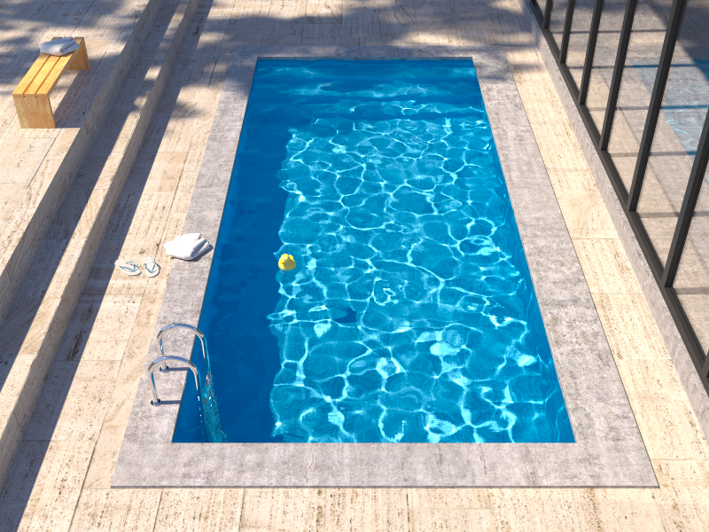
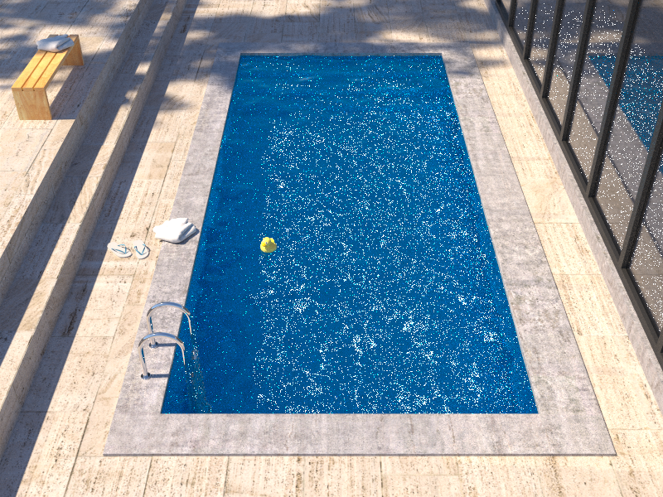
Insufficient path sampling techniques
Reference solution
Bidirectional path tracing
Notes:
Bidirectional path tracing is much more robust than path tracing, light tracing, or VPL rendering.
However, it still struggles with some lighting effects, the most common of which are the specular-diffuse-specular (SDS) paths corresponding to reflected caustics – in this example the caustics at the pool bottom.

Slide 3
Insufficient path sampling techniques
Some paths sampled with zero (or very small) probability
specular – S
diffuse – D
Notes:
As usual, the culprit is inappropriate path sampling. The problem is that none of the path sampling techniques used in bidirectional path tracing is efficient at sampling the SDS effects, so their combination cannot sample those effects either.
To see this, consider the example on the slide. We have a pool (diffuse – D) filler with water (specular – S), a pinhole camera, and a small light source.
No path connections are possible because of the two specular vertices. Unidirectional sampling from the light source is not possible either because of the pinhole camera.
So we are left with one single (unidirectional) path sampling technique that starts from the camera, and hopes to randomly strike the light source. It is not hard to see that the smaller the source, the lower the probability of hitting the source and the higher the estimator variance.
In the limit, for point sources and pinhole camera, the SDS effects cannot be sampled by local path sampling at all.

Slide 4
Photon mapping (Density estimation)
Many fwd walks + store particles (“photon map”)
Radiance estimate: (Kernel) density estimation
Notes:
Photon mapping – a computer graphics name for a light transport technique based on non-parametric density estimation – is well known for its efficient handling of caustics and reflected caustics.
The algorithm proceeds in two stages.
In the first stage, a large number of particle histories (light paths) are traced starting from the light source. Every time the particle scatters, we store it in a data structure called the “photon map”.
In the second stage, we generate the image by tracing sub-paths starting from the camera and whenever we hit a non-specular object, we estimate the radiance by a “photon map lookup” and terminate the walk.
The photon map lookup estimates the radiance using a non-parametric density estimation technique; k-NN density estimation is most common. This involves finding the k nearest neighboring particles in the photon map and estimating the radiance as a weighted density of these particles.

Slide 5
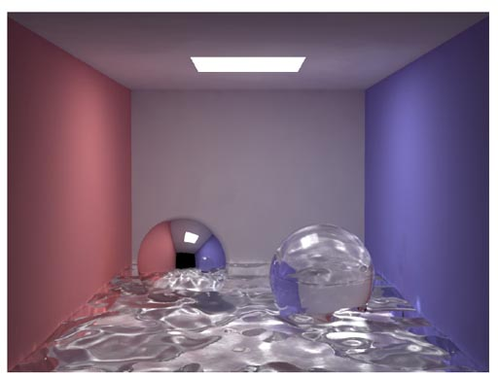
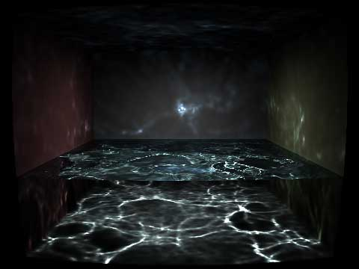
Photon mapping – SDS paths
© H.W.Jensen
© Wojciech Jarosz

Slide 6
Photon mapping overview
Paths are followed both from the light sources and from the camera
Similar to bidirectional path tracing
But the sub-path connection strategy significantly differs
Reuse of light sub-paths for all pixels
Photon map = “light sub-path cache”
Essential for good performance
For the same quality often faster than pure MC techniques
Biased!
But can be made consistent (i.e. converges as the photon count increases, cf. progressive photon mapping)

Slide 7
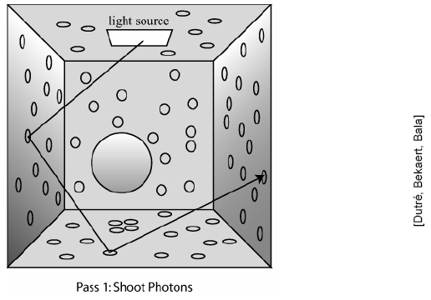
Calculation steps
Photon tracing
“Photons” emitted from light sources,
traced through the scene (a la light tracing),
and stored in a photon map
Rendering with photon maps
Similar to distributed path tracing
Recursion replaced by a photon map lookup

Slide 8
Phase 1: Photon tracing
Emission of photons from light sources
Tracing of photon paths
Storage into the “photon map” (=photon list)

Slide 9
Photon emission
Goal
All emitted photons carry the same (or similar) flux (so that the variance of photon map radiance estimates is low)
Emission of a single photon (i.e. of a single sub-path)
Choose the light source
Randomly with a probability proportional to its total flux
Choose the photon origin
The light position for point sources
Randomly chosen position for area sources
Choose the photon direction
Randomly according to the emission distribution of the source

Slide 10
Photon emission
Flux of the emitted photon:
Total number of
emitted photon paths
Pdf for sampling position x₀ and direction ω₀
(Discrete) probability of choosing the light source l

Slide 11
Photon emission
“Ideal” sampling
All emitted photons carry the same flux:

Slide 12
Tracing of photon paths
Similar to light tracing
Photon-surface intersection:
Store “photon” into a photon map
photon = (position, incident direction, flux)
Generate reflected direction
BRDF importance sampling
Update photon flux
(next slide)
Russian roulette – randomized absorption (termination)
(next slide)
Objective
Keep the photon flux close to its original value

Slide 13
Photon tracing
Update photon flux
Russian roulette – randomized photon absorption
The above strategy keeps the photon flux roughly constant
Survival probability
Updated photon flux on survival

Slide 14
Photon tracing
Attention to light refraction
Recall: When tracing paths from the camera, we need to update radiance according to the 2nd power of the relative IOR
But photon do not carry radiance but flux – no flux change upon refraction

Slide 15
Photon map
Storage of photons into a photon map
Upon each interaction of a photon with a diffuse (or moderately glossy, but not mirror) surface (even on absorption)
Photon map
A simple linear list of photons during photon tracing
After photon tracing, we build a kD-tree for faster search
Photon
position: x_{p} = (x, y, z)
incident direction: ω_{p} = (θ, φ)
energy (flux): Φ_{p} = (r, g, b)
Number of photons: 10⁶ – 10⁷ sufficient in many scenes

Slide 16
Photon map
Image: Henrik Wann Jensen

Slide 17
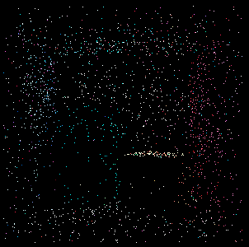
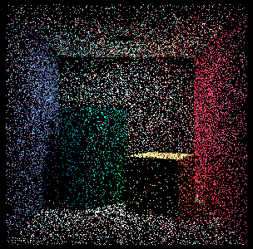
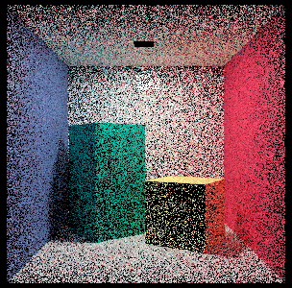
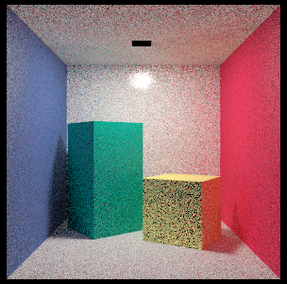
Photons represent the equilibrium radiance in the scene

Slide 18
Two photon maps
Caustics map
Global map

Slide 19
Two photon maps
Global map: L[S|D]*D
Contains even direct illumination
Caustics map: LS⁺D
Contains indirect illumination only
Is a subset of the global map
Different use of the two maps in image rendering
It’s more advantageous to keep them separate
Light path grammar
E … eye, L … light, D … diffuse, S … specular
G … glossy (often included in D)

Slide 20
Getting the photon maps ready for rendering
During photon tracing, photons are simply appended into a linear list
After that, we build a spatial search acceleration structure
In rendering we need to quickly locate k nearest photons
kD-tree or hashed uniform grid

Slide 21
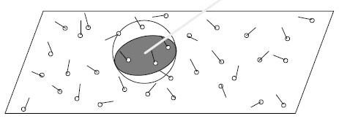
Radiance estimate from a photon map
ΔA
k .. #photons around x
incident direction of photon p
Surface area of ΔA

Slide 22
Radiance estimate from a photon map
RadianceEstimate(x, wo):
Color L = (0,0,0);
int k = locateNearestPhotons(x, wo, n_max, nearest, r);
// ‘nearest’ is an array of k nearest photons to x
// r is the distance from x to the farthest of them
if ( k < 5 ) return L;
for p = 1 to k do
{
if( dot ( nearest[p].wi, N) <= 0 ) continue;
L += fr(x, wo, nearest[p].wi) * nearest[p].flux;
}
return L / (M_PI * r*r);

Slide 23
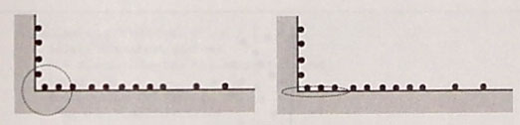
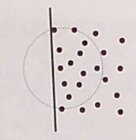
Radiance estimate – issues
Incorrect photons included in the search
Incorrect estimate of the surface area ΔA
Next to a wall, a caustic or geometry edge
© H.W.Jensen

Slide 24
Fast search of nearest phtons
Needed for the radiance estimate
Search of the nearest photons is an instance of
k-nearest neighbor search (k-NN)

Slide 25
k-D tree – Construction
Recursive space subdivision along the axis with maximum span
Subdivision
Splitting plane can be in the spatial center (faster, ok) or through the median of photons
When using the median split rule, the resulting tree is perfectly balanced and can be stored in a linear array
Descendants of the photon at index i are at indexes 2i a 2i+1

Slide 26
k-D tree – Nearest neighbor search
Pruning of the search
Either: According to the distance to the already located k-th nearest photon (when searching k nearest)
Photons located so far are maintained in a max-heap
Or: According to the search radius r (when locating particles witin a fixed radius – „range query“)

Slide 27
Phase 2: Rendering with photon maps
Distributed ray tracing from the camera
Recursion replaced by a photon map lookup
For highly specular surfaces we still use recursion as in classic path tracing

Slide 28
Reflected radiance calculation
Reflected radiance: this is what we want to calculate
Split the incoming radiance
Split the BRDF
direct illumination
highly specular reflections / refractions
caustics
(PM)
diffuse indirect
(FG +PM)
PM … photon map FG … final gathering

Slide 29
Reflected radiance calculation
When not using photon maps
Direct illumination
As usual: light source area sampling + shadow rays
Ideal mirror reflections / refractions
As usual: deterministic secondary rays
With photon maps
...

Slide 30
Illumination calculation for a primary ray (or after a mirror reflection)
Using the photon map
Caustics
Radiance estimate from the caustic photon map
Indirect illumination on diffuse or moderately glossy surfaces
Final gathering ...

Slide 31
Final gathering (FG)
Indirect illumination on diffuse and moderately glossy surfaces
One level of recursion as in distributed ray tracing (i.e. path tracing with massive splitting)
For the intersection of secondary rays, use radiance estimate from the global photon map
No need to explicitly calculate direct illumination (it is contained in the global photon map)

Slide 32
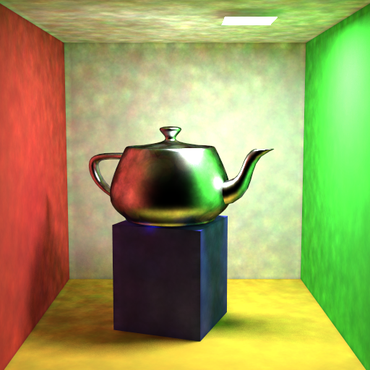
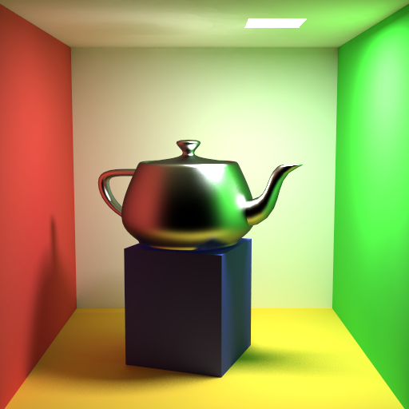

Why do we need final gathering?
Direct use of the PM
final gathering
500 – 5000 rays
Information in the global photon map is too noisy for a direct use
Inaccuracy in the global photon map is “averaged out”

Slide 33
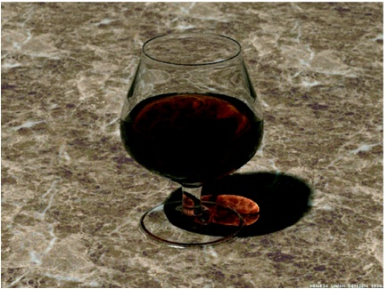
Why is there no final gathering for caustics?
Caustics = light focusing => sufficient photon density (beware, it’s just a heuristic, may not always work well)

Slide 34
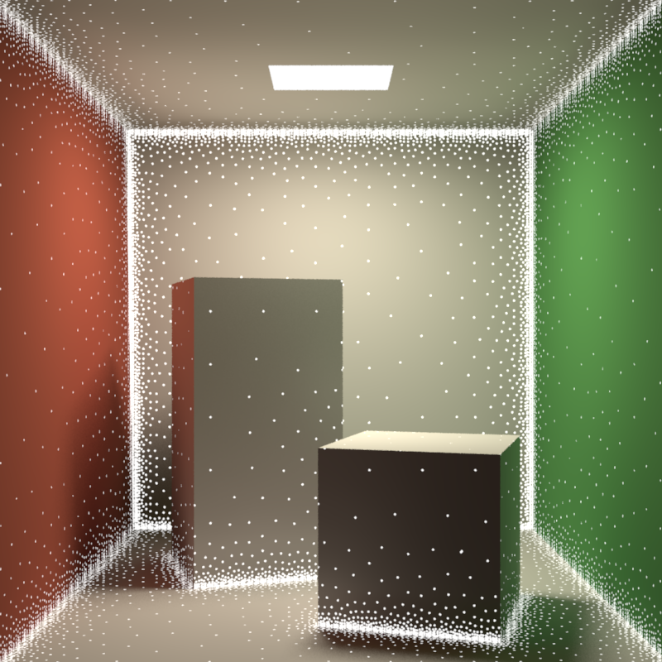
Accelerating final gathering
Irradiance caching (next time)

Slide 35
Results
přímé osvětlení (21 s)
kaustiky (45 s)
GI (66 s)
50 000 photons in the caustic map
200 000 photons in the global map

Slide 36
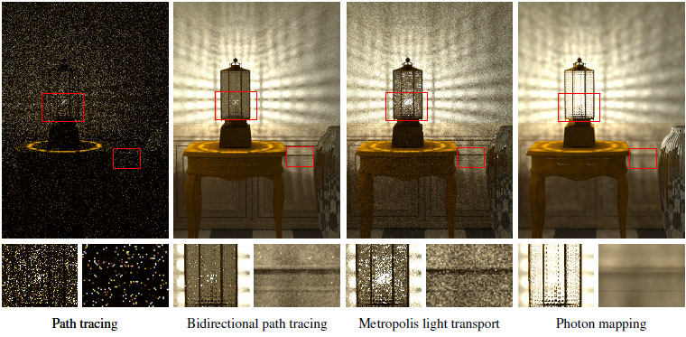
What is photon mapping good at?
Directly and indirectly visible caustics
More generally: SDS paths (like light on the pool bottom)
Classic MC algorithms fail in such cases (path tracing, bidirectional path tracing, metropolis light transport)
© Hachisuka et al.

Slide 37
SDS paths
© H.W.Jensen
© Wojciech Jarosz

Slide 38
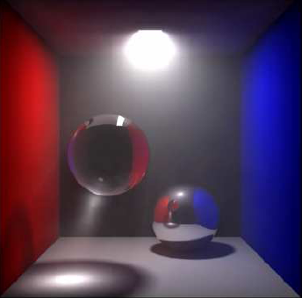
Photon mapping can be easily extended to handle scattering in media
Henrik Wann Jensen

Slide 39
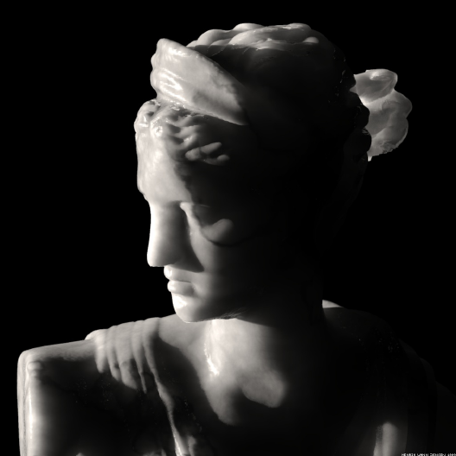
… and subsurface scattering

Slide 40
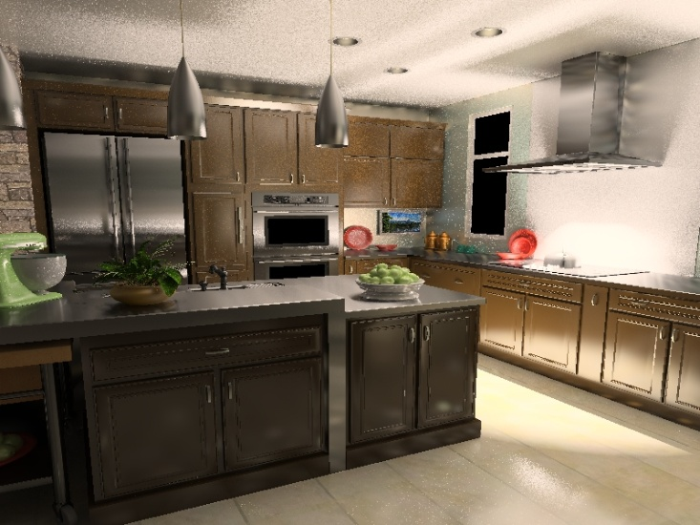
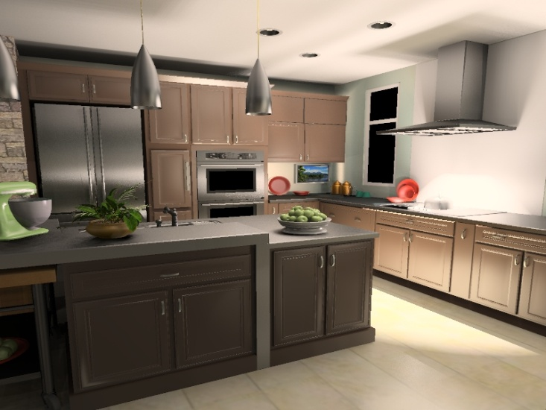
Photon mapping problems
Does not work well on glossy surfaces
Photon mapping
reference

Slide 41
Photon mapping problems
Does not work well on glossy surfaces
So, what’s wrong?
Radiance estimate from the photon map on a glossy surface suffers from high variance

Slide 42
Theoretical problems of photon mapping
Result is not unbiased
Contains systematic error
Result is consistent
It theoretically converges as the photon count goes to infinity
But this is practically unachievable
Solution: progressive photon mapping

Slide 43
Progressive photon mapping

Slide 44
Progressive photon mapping
Rendering in iterations
In each iteration, reduce the photon search radius such that:
Total bias goes to zero, and
Total variance goes to zero
(i.e. the resulting estimator is consistent)

Slide 45
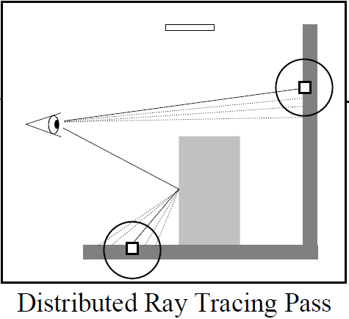
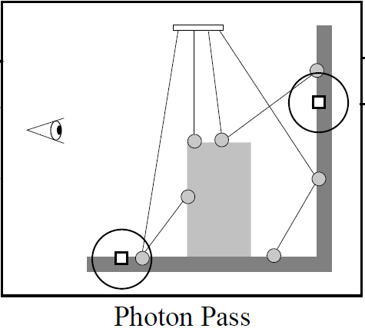
Progressive photon mapping
Iterative procedure
© Hachisuka et al.

Slide 46
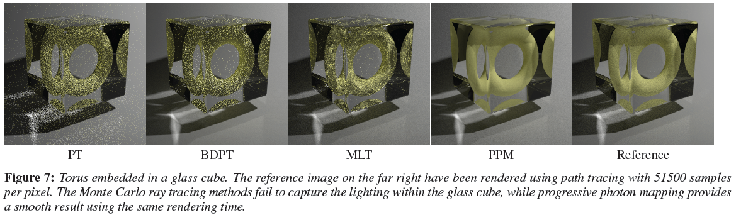
Progressive photon mapping

Slide 47
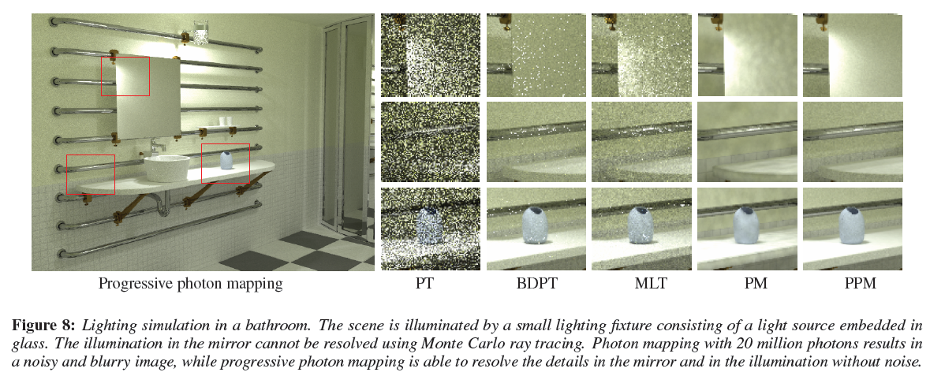
Progressive photon mapping

Slide 48
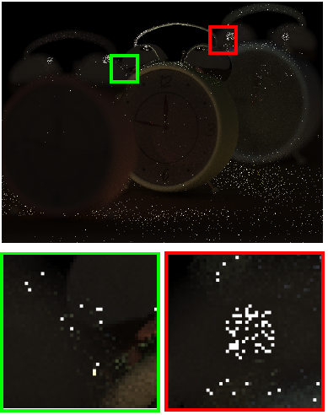
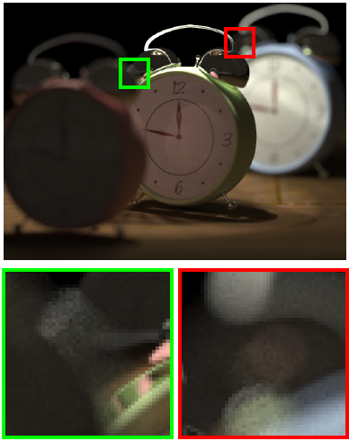
Progressive photon mapping
BDPT
PPM

Slide 49
Our work: Vertex Connection and Merging

Slide 50
Robust photon mapping
Where exactly on the camera sub-path should we look-up the photons?
Commonly solved via a heuristic:
Diffuse surface … make the look-up right away
Specular surface … continue tracing and make the look-up later
But what exactly should be classified as “diffuse” and “specular”?
We need a more universal and robust solution
Solution:
Bidirectional photon mapping [Vorba 2011]
Vertex Connection and Merging [Georgiev et al., 2012]

Slide 51
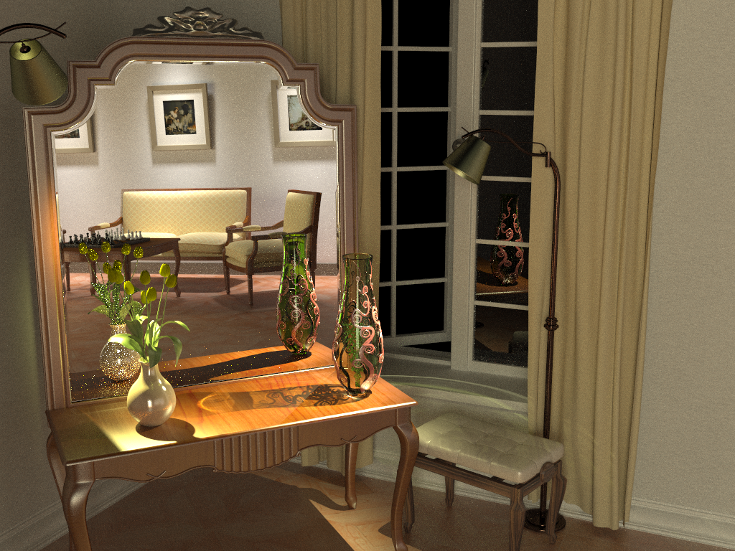
Bidirectional path tracing (30 min)
Notes:
This example, we saw that bidrectional path tracing and photon mapping are pretty much complementary in terms of their strengths and weaknesses. BPT cannot do reflected caustics, but is really good at the overall diffuse illumination.

Slide 52
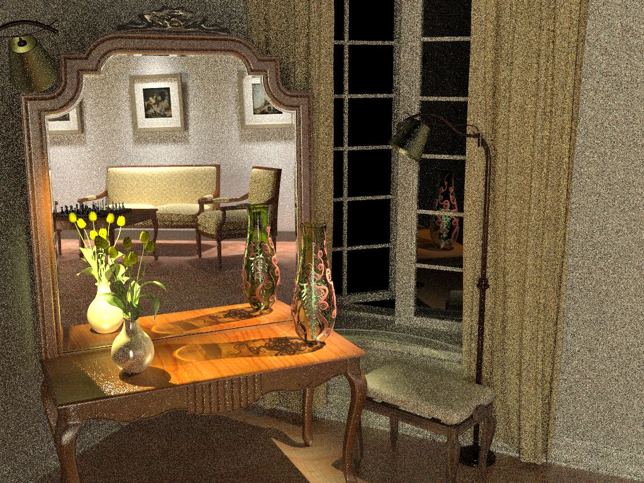
Photon mapping (Density estimation) (30 min)
Notes:
And vice versa for photon mapping.

Slide 53
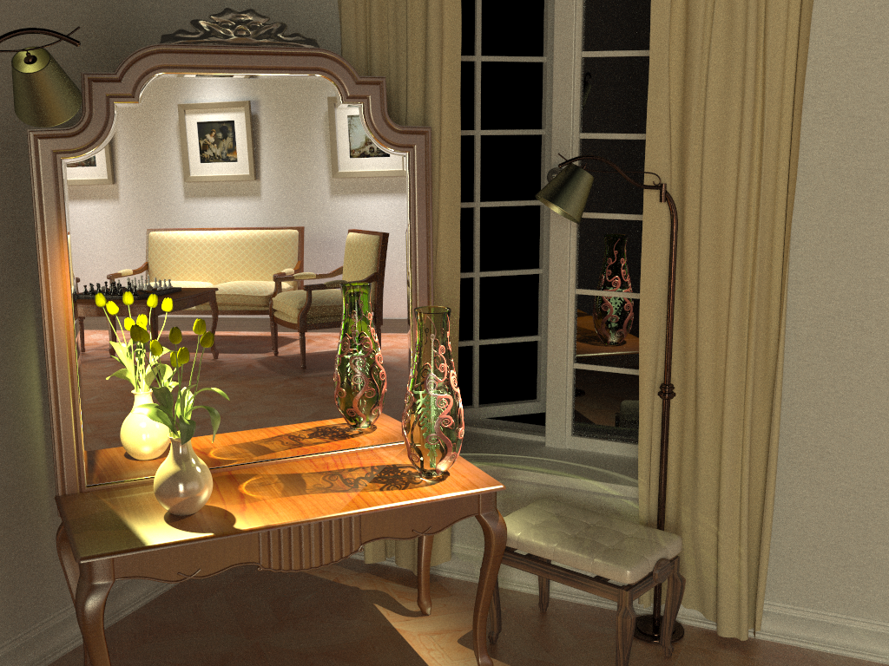
Vertex connection and merging (30 min)
Notes:
By using multiple importance sampling to combine estimators from bidirectional path tracing and photon mapping, the algorithm I will talk about today automatically finds a good mixture of techniques for each individual light transport path, and produces a clean image in the same amount of time.

Slide 54
BPT vs PM
Unidirectional sampling
Vertex connection
Density estimation
Bidirectional path tracing
Photon mapping
Notes:
Let us start by reviewing how bidirectional path tracing (BPT) and photon mapping (PM) sample light transport paths that connect the light sources to the camera:
[CLICK] The techniques BPT employs can be roughly categorized to unidirectional sampling (US) and vertex connection (VC). [CLICK] US constructs a path by starting either from a light source or the camera and tracing a random walk in the scene until termination. [CLICK] On the other hand, VC traces one subpath from a light source and another one from the camera, and then completes a full path by connects their endpoints.
[CLICK] In contrast, PM first traces a number of light subpaths and stores their vertices, a.k.a. photons. It then traces subpaths from the camera and computes the outgoing radiance at the hit points using density estimation by looking up nearby photons.

Slide 55
Overview
Problem: different mathematical frameworks
BPT: Monte Carlo estimator of a path integral
PM: Density estimation
Key contribution: Reformulate photon mapping in Veach’s path integral framework
Formalize as path sampling technique
Derive path probability density
Combination of BPT and PM into a robust algorithm
Notes:
However, even though both methods have been published more than 15 years ago, neither a rigorous analysis of their relative performance nor an efficient combination had been shown until very recently. The reason for this is that BPT and PM have originally been defined in different theoretical frameworks – BPT as a standard Monte Carlo estimator to the path integral, and PM as an outgoing radiance estimator based on photon density estimation.
The first step toward combining these two methods is to put them in the same mathematical framework. We choose Veach’s path integral formulation of light transport, as it has a number of good properties and also because BPT is already naturally defined in this framework.
We need two key ingredients: (1) express PM as a sampling technique that constructs light transport paths that connect the light sources to the camera, and (2) derive the probability densities for paths sampled with this technique. This will give us a basis for reasoning about the relative efficiency of BPT and PM. And more importantly, it will lay the ground for combining their corresponding estimators via multiple importance sampling.

Slide 56
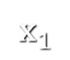
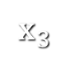
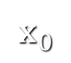
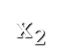
Bidirectional MC path sampling
Notes:
Let us start by taking a simple length-3 path and see how it can be constructed bidirectionally.

Slide 57
Bidirectional MC path sampling
Light vertex
Camera vertex
Notes:
We first trace one subpath from the camera and another one from a light source.

Slide 58
Bidirectional MC path sampling
Light vertex
Camera vertex
Bidirectional path tracing
Photon mapping
Notes:
Now let’s see how we complete a full path in BPT and PM.

Slide 59
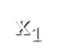

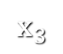
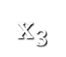
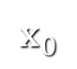

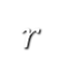
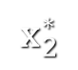
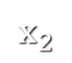
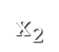
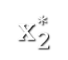
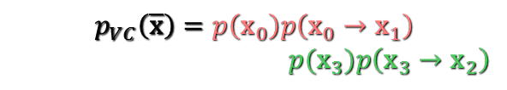
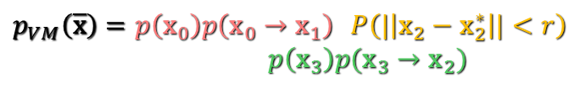
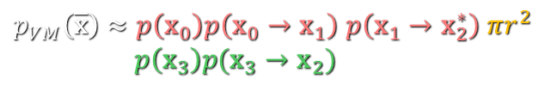
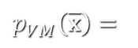
Bidirectional MC path sampling
Light vertex
Camera vertex
Vertex connection
Vertex merging
Bidirectional path tracing
Photon mapping
$$p_{VC}\left(\overline{\text{x}}\right)=p\left({\text{x}}_{0}\right)p\left({\text{x}}_{0}→{\text{x}}_{1}\right)$$
$p({\text{x}}_{3})p\left({\text{x}}_{3}→{\text{x}}_{2}\right)$
$p_{VM}\left(\overline{\text{x}}\right)=p\left({\text{x}}_{0}\right)p\left({\text{x}}_{0}→{\text{x}}_{1}\right)$ $P\left(|\left|{\text{x}}_{2}−{\text{x}}_{2}^{∗}\right||<r\right)$
$p\left({\text{x}}_{3}\right)p({\text{x}}_{3}→{\text{x}}_{2})$
$p_{VM}\left(\overline{\text{x}}\right)≈p\left({\text{x}}_{0}\right)p\left({\text{x}}_{0}→{\text{x}}_{1}\right)$ $p\left({\text{x}}_{1}→{\text{x}}_{2}^{∗}\right) πr^{2}$
$p\left({\text{x}}_{3}\right)p({\text{x}}_{3}→{\text{x}}_{2})$
$$p_{VM}\left(\overline{\text{x}}\right)=$$
Notes:
Bidirectional path tracing connects the subpath endpoints deterministically.
[CLICK] We call this technique vertex connection. The PDF of the resulting full path is well known, and is simply the product of the PDFs of two subpaths, which have been sampled independently.
[CLICK] Photon mapping, on the other hand, will extend the light subpath by sampling one more vertex from ${\text{x}}_{1}$, and will concatenate the two subpaths only if the “photon” hit-point ${\text{x}}_{2}^{∗}$ lies within a distance $r$ from ${\text{x}}_{2}$.
[CLICK] We label this technique vertex merging, as it can be intuitively thought to weld the endpoints of the two subpaths if they lie close to each other.
[CLICK] What remains is to derive the PDF of the resulting full path. To do this, we can interpret the last step as establishing a regular vertex connection between ${\text{x}}_{1}$ and ${\text{x}}_{2}$, but conditioning its acceptance on the random event that a vertex ${\text{x}}_{2}^{∗}$ sampled from ${\text{x}}_{1}$ lands within a distance $r$ to ${\text{x}}_{2}$. The full path PDF is then again the product of the subpath PDFs, but in addition multiplied by the probability of sampling the point ${\text{x}}_{2}^{∗}$ within a distance $r$ of ${\text{x}}_{2}$. This acceptance probability is equal to the integral of the PDF of ${\text{x}}_{2}^{∗}$ over the $r$-neighborhood of ${\text{x}}_{1}$.
[CLICK] Under the reasonable assumptions that the surface around ${\text{x}}_{1}$ is locally flat, i.e. that this neighborhood is a disk, and that the density of ${\text{x}}_{2}^{∗}$ is constant inside this disc, the integral can be well approximated by the PDF of the actual point ${\text{x}}_{2}^{∗}$ we have sampled, multiplied by the disc area $πr^{2}$.

Slide 60
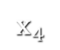
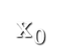
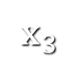













Sampling techniques
Light vertex
Camera vertex
Unidirectional
2 ways
Vertex connection
4 ways
Vertex merging
5 ways
Total
11 ways
Notes:
Now that we have formulated the vertex merging path sampling technique, we can put it side by side with the already available techniques in BPT. There are two ways to sample a length-4 path unidirectionally, and four ways to sample it via vertex connection. Vertex merging adds five new ways to sample the path, corresponding to merging at the five individual path vertices. In practice, we can avoid merging at the light source and the camera, as directly evaluating emission and sensitivity is usually cheap.
But with so many ways to sample the same light transport path, a question naturally arises in the mind of the curious: which technique is the most efficient for what types of paths?

Slide 61





Technique comparison – SDS Paths
Diffuse light
Diffuse surface
Mirror surface
Unidirectional sampling
Vertex merging
Vertex merging (reuse)
BPT: Unidirectional sampling
PM: Vertex merging
Roughly equal path sampling probabilities
Roughly equal total number of rays per image!
10k paths/pixel
10k paths/pixel
1.2 billion paths/pixel
Notes:
To answer this question, let us first take a look at specular-diffuse-specular (SDS) paths. Here, bidirectional path tracing can only rely on unidirectional sampling: it traces a path from the camera hoping to randomly hit the light source. With vertex merging, we can trace one light and one camera subpath, and merge their endpoints on the diffuse surface.
[CLICK] It can be shown that if the light source and the merging disk have the same area $A$, then unidirectional sampling and vertex merging sample paths with roughly the same probability density. This means that we should expect the two techniques to perform similarly in terms of rendering quality.
[CLICK] We render these two images progressively, sampling one full path per pixel per iteration. For the left image we trace paths from the camera until they hit the light. For image on the right, we trace subpaths from both ends, and merge their endpoints if they lie within a distance $r=\sqrt{A/π}$ from each other. Both images look equally noisy, even after sampling 10,000 paths per pixel. This confirms that vertex merging, and thus photon mapping, is not an intrinsically more robust sampling technique for SDS paths than unidirectional sampling.
[CLICK] However, the strength of vertex merging is computational efficiency – we can very efficiently reuse the light subpaths traced for all pixels at the cost of a single range search query. This allows us to quickly construct orders of magnitude more light transport estimators from the same sampling data, with a minimal computational overhead, resulting in a substantial quality improvement.
[CLICK] For all these three images we have traced roughly the same number of rays, and the only difference between the one in the center and the one on the right is that the for right image we have enabled path reuse, by storing, and looking up, the light subpath vertices in a photon map at every rendering iteration.

Slide 62

VCM – Algorithm overview
Stage 1: Light sub-path sampling
a) Trace sub-paths
b) Connect to eye
c) Build search struct.
Stage 2: Eye sub-path sampling
VC
VC
VM
VM
a) Vertex connection
b) Vertex merging
c) Continue sub-path
Notes:
Even more usefully, we now have the necessary ingredients for combining photon mapping and bidirectional path tracing into one unified algorithm. The vertex merging path PDFs tell us how to weight all sampling techniques in multiple importance sampling, and the insights from the previous two slides command to strive for path reuse.
The combined algorithm, which we call vertex connection and merging (VCM), operates in two stages.
In the first stage, we
[CLICK] trace the light subpaths for all pixels,
[CLICK] connect them to the camera, and
[CLICK] store them in a range search acceleration data structure (e.g. a kd-tree or a hashed grid).
[CLICK] In the second stage, we trace a camera subpath for every pixel.
[CLICK] Each sampled vertex on this path is connected to a light source (a.k.a. next event estimation), connected to the vertices of the light subpath corresponding to that pixel, and
[CLICK] merged with the vertices of all light subpaths.
[CLICK] We then sample the next vertex and do the same.
In a progressive rendering setup, we perform these steps at each rendering iteration, progressively reducing the vertex merging radius . For details on this, please refer to the cited papers below for details.

Slide 63

Bidirectional path tracing (30 min)
Notes:
Let us now see how this combined algorithm stacks up against bidirectional path tracing and stochastic progressive photon mapping on a number of scenes with complex illumination.

Slide 64

Stochastic progressive photon mapping (30 min)

Slide 65

Vertex connection and merging (30 min)

Slide 66


VM
Relative technique contributions
VC
Notes:
Here, we visualize the relative contributions of VM and VC techniques to the VCM image from the previous slide. This directly corresponds to the weights that VCM assigned to these techniques.

Slide 67

Bidirectional path tracing (30 min)

Slide 68

Stochastic progressive photon mapping (30 min)

Slide 69

Vertex connection and merging (30 min)

Slide 70

PM
Relative technique contributions
BPT

Slide 71

Bidirectional path tracing (30 min)

Slide 72

Stochastic progressive photon mapping (30 min)

Slide 73

Vertex connection and merging (30 min)

Slide 74

PM
Relative technique contributions
BPT

Slide 75



Remaining challenges
VCM
VCM
BPT
Notes:
Even though VCM is a step forward in Monte Carlo rendering and has proven very useful in practice, it doesn’t come without limitations. Specifically, it cannot handle more efficiently those types of light transport paths that are difficult for both BPT and PM to sample.
[CLICK] A prominent example are caustics falling on a glossy surface.
[CLICK] On this kitchen scene, even though VCM brings practical improvements over BPT, there is still a lot to be desired from the caustics on the glossy surface.

Slide 76
References
Georgiev et al., “Light Transport Simulation with Vertex Connection and Merging”
Hachisuka et al. “A Path Space Extension for Robust Light Transport Simulation”
Same algorithm, different theoretical derivations

Slide 77




VCM in production
Notes:
A number of companies have announced VCM integration in the upcoming releases of their commercial renderers.
For example, VCM is coming in Pixar’s Photorealistic RenderMan v19, …

Slide 78
References
Jensen H.W.: Realistic Image Synthesis using Photon Mapping. A.K. Peters, 2001
Hachisuka & Jensen. Stochastic Progressive Photon Mapping, ACM Trans. Graph. (SIGGRAPH Asia 2009). link
Knaus & Zwicker. Progressive photon mapping: A probabilistic approach. ACM Trans. Graph., 2011. link
Georgiev, Křivánek, Davidovič, Slusallek. Light Transport Simulation with Vertex Connection and Merging. ACM Trans. Graph. (SIGGRAPH Asia 2012). link
Hachisuka, Pantaleoni, Jensen. A Path Space Extension for Robust Light Transport Simulation. ACM Trans. Graph. (SIGGRAPH Asia 2012). link

